Slide 1

Algoritmos y Programación I
Curso Essaya - 75.40 / 95.14 Clase 13 Procesamiento de archivos

Slide 2
Datos estructurados
ID | Nombre | Apellido | email
1 | Mark | Zuckerberg | mark@facebook.com
2 | Kaleigh | Paucek | alexys.parisian@example.org
3 | Guiseppe | Ritchie | nienow.jakob@example.org
4 | Gerardo | Kohler | arielle91@example.net
5 | Tressie | Keebler | hosea.roob@example.net
6 | Ethelyn | Marquardt | leola.hahn@example.com
7 | Kaylee | Hirthe | clyde.toy@example.net
8 | Dario | O'Kon | lang.rylee@example.org
9 | Verona | Pacocha | wunsch.mervin@example.org
10 | hoebe | Walsh | baumbach.torrey@example.net
?

Slide 3

Datos estructurados
JSON
import json
[
{"id":1,
"nombre":"Mark",
"apellido":"Zuckerberg",
"email":"mark@facebook.com"},
{"id":2,
"nombre":"Kaleigh",
"apellido":"Paucek",
"email":"parisian@example.org"}
]
Formato binario
0110101001000101010101
0111101001010101010010
0010010111010000101001
1101010100100100100100
0110010100101001001011
import pickle
import struct
XML
import xml
CSV
import csv
<users>
<user id="1"
nombre="Mark"
apellido="Zuckerberg"
email="mark@facebook.com"
/>
<user id="2"
nombre="Kaleigh"
apellido="Paucek"
email="parisian@example.org"
/>
</users>
1,Mark,Zuckerberg,mark@facebook.com
2,Kaleigh,Paucek,alexys.parisian@example.org
3,Guiseppe,Ritchie,nienow.jakob@example.org
4,Gerardo,Kohler,arielle91@example.net
5,Tressie,Keebler,hosea.roob@example.net
6,Ethelyn,Marquardt,leola.hahn@example.com
7,Kaylee,Hirthe,clyde.toy@example.net
8,Dario,O'Kon,lang.rylee@example.org
9,Verona,Pacocha,wunsch.mervin@example.org
10,Phoebe,Walsh,baumbach.torrey@example.net

Slide 4

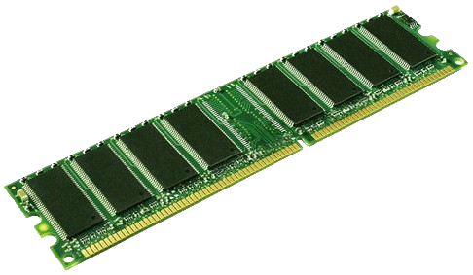
Nombres
Valores
Procesador
Memoria RAM
s
"hola"
s = "Hola"

Slide 5


1 GB
Nombres
Valores
Procesador
Memoria RAM
s
"Ir al super\nHacer el TP\nCargar la SUBE\n"
with open("tareas.txt") as f:
s = f.read()
39 bytes
tareas.txt
Ir al super
Hacer el TP
Cargar la SUBE
Dispositivo de almacenamiento

Slide 6

1 GB
Nombres
Valores
Procesador
Memoria RAM
with open("...") as f:
s = f.read()
120 GB
usuarios-facebook.csv
1,Mark,Zuckerberg,mark@facebook.com
2,Kaleigh,Paucek,alexys.parisian@example.org
3,Guiseppe,Ritchie,nienow.jakob@example.org
4,Gerardo,Kohler,arielle91@example.net
5,Tressie,Keebler,hosea.roob@example.net
6,Ethelyn,Marquardt,leola.hahn@example.com
7,Kaylee,Hirthe,clyde.toy@example.net
8,Dario,O'Kon,lang.rylee@example.org
9,Verona,Pacocha,wunsch.mervin@example.org
10,Phoebe,Walsh,baumbach.torrey@example.net
...
...
Dispositivo de almacenamiento

Slide 7
btc.csv
https://www.kaggle.com/mczielinski/bitcoin-historical-data
Year,Month,Day,Hour,Minute,Open,High,Low,Close,Volume_(BTC),Volume_(Currency),Weighted
2011,12,31,4,52,4.39,4.39,4.39,4.39,0.45558087,2.0000000193,4.39
2011,12,31,4,53,4.39,4.39,4.39,4.39,0.45558087,2.0000000193,4.39
2011,12,31,4,54,4.39,4.39,4.39,4.39,0.45558087,2.0000000193,4.39
2011,12,31,4,55,4.39,4.39,4.39,4.39,0.45558087,2.0000000193,4.39
2011,12,31,4,56,4.39,4.39,4.39,4.39,0.45558087,2.0000000193,4.39
2011,12,31,4,57,4.39,4.39,4.39,4.39,0.45558087,2.0000000193,4.39
2011,12,31,4,58,4.39,4.39,4.39,4.39,0.45558087,2.0000000193,4.39
2011,12,31,4,59,4.39,4.39,4.39,4.39,0.45558087,2.0000000193,4.39
2011,12,31,5,0,4.39,4.39,4.39,4.39,0.45558087,2.0000000193,4.39
2011,12,31,5,1,4.39,4.39,4.39,4.39,0.45558087,2.0000000193,4.39
2011,12,31,5,2,4.39,4.39,4.39,4.39,0.45558087,2.0000000193,4.39
2011,12,31,5,3,4.39,4.39,4.39,4.39,0.45558087,2.0000000193,4.39
2011,12,31,5,4,4.39,4.39,4.39,4.39,0.45558087,2.0000000193,4.39
2011,12,31,5,5,4.39,4.39,4.39,4.39,0.45558087,2.0000000193,4.39
2011,12,31,5,6,4.39,4.39,4.39,4.39,0.45558087,2.0000000193,4.39
2011,12,31,5,7,4.39,4.39,4.39,4.39,0.45558087,2.0000000193,4.39
2011,12,31,5,8,4.39,4.39,4.39,4.39,0.45558087,2.0000000193,4.39
2011,12,31,5,9,4.39,4.39,4.39,4.39,0.45558087,2.0000000193,4.39
2011,12,31,5,10,4.39,4.39,4.39,4.39,0.45558087,2.0000000193,4.39
2011,12,31,5,11,4.39,4.39,4.39,4.39,0.45558087,2.0000000193,4.39
2011,12,31,5,12,4.39,4.39,4.39,4.39,0.45558087,2.0000000193,4.39
2011,12,31,5,13,4.39,4.39,4.39,4.39,0.45558087,2.0000000193,4.39
2011,12,31,5,14,4.39,4.39,4.39,4.39,0.45558087,2.0000000193,4.39
...
...
$ python reporte_btc.py
total 2011: ??
total 2012: ??
total 2013: ??
total 2014: ??
total 2015: ??
total 2016: ??
total 2017: ??
total 2018: ??
total: ??

Slide 8
Corte de control
import csv
def corte_control_btc():
"""
A partir del archivo btc.csv, imprime totales y máximos por mes, año y global
"""
with open('datasets/btc/btc.csv') as f:
r = csv.reader(f)
# saltear el encabezado
next(r)
fila = next(r, None)
total = 0
total_max = 0
while fila:
year = fila[0]
year_total = 0
year_max = 0
while fila and fila[0] == year:
month = fila[1]
month_total = 0
month_max = 0
while fila and fila[0] == year and fila[1] == month:
vol = float(fila[-3])
high = float(fila[6])
month_total += vol
month_max = max(month_max, high)
fila = next(r, None)
print(f'total {year}/{month}: {month_total:.2f}, max: {month_max:.2f}')
year_total += month_total
year_max = max(year_max, month_max)
print(f'total {year}: {year_total:.2f}, max: {year_max:.2f}')
total += year_total
total_max = max(total_max, year_max)
print(f'total: {total:.2f}, max: {total_max:.2f}')

Slide 9
https://www.kaggle.com/CooperUnion/anime-recommendations-database
anime.csv
anime_id,name,genre,type,episodes,rating,members
1,Cowboy Bebop,"Action, Adventure, Comedy, Drama, Sci-Fi, Space",TV,26,8.82,486824
5,Cowboy Bebop: Tengoku no Tobira,"Action,Drama,Mystery,Sci-Fi,Space",Movie,1,8.40,137636
6,Trigun,"Action, Comedy, Sci-Fi",TV,26,8.32,283069
7,Witch Hunter Robin,"Action, Drama, Magic, Mystery, Police, Supernatural",TV,26,7.36,64905
8,Beet the Vandel Buster,"Adventure, Fantasy, Shounen, Supernatural",TV,52,7.06,9848
15,Eyeshield 21,"Action, Comedy, Shounen, Sports",TV,145,8.08,83648
16,Hachimitsu to Clover,"Comedy, Drama, Josei, Romance",TV,24,8.18,130646
17,Hungry Heart: Wild Striker,"Comedy, Shounen, Slice of Life, Sports",TV,52,7.74,13469
...
$ python reporte_anime.py
Cowboy Bebop: ??
Cowboy Bebop: Tengoku no Tobira: ??
Trigun: ??
Witch Hunter Robin: ??
Beet the Vandel Buster: ??
Eyeshield 21: ??
Hachimitsu to Clover: ??
Hungry Heart: Wild Striker: ??
Initial D Fourth Stage: ??
Monster: ??
...
rating.csv
user_id,anime_id,rating
13,1,-1
19,1,10
21,1,9
23,1,9
32,1,10
34,1,7
43,1,10
46,1,10
50,1,10
51,1,10
...

Slide 10
Apareo
import csv
def apareo_anime():
"""
A partir de los archivos anime.csv con los títulos, y ratings.csv con el voto de
cada usuario, imprime: "titulo - promedio - (cant. de votos)"
"""
with open('datasets/anime/anime.csv') as anime, open('datasets/anime/rating.csv') as rating:
csv_anime = csv.reader(anime)
csv_rating = csv.reader(rating)
# saltear los encabezados
next(csv_anime)
next(csv_rating)
fila_anime = next(csv_anime, None)
fila_rating = next(csv_rating, None)
while fila_anime:
anime_id = fila_anime[0]
anime_nombre = fila_anime[1]
cantidad = 0
suma = 0
while fila_rating and fila_rating[1] == anime_id:
voto = int(fila_rating[2])
if voto != -1:
cantidad += 1
suma += voto
fila_rating = next(csv_rating, None)
if cantidad > 0:
print(f"{anime_nombre}: {suma/cantidad:.2f} ({cantidad})")
else:
print(f"{anime_nombre}: (no tiene votos)")
fila_anime = next(csv_anime, None)

Slide 11
Bonus tracks

Slide 12
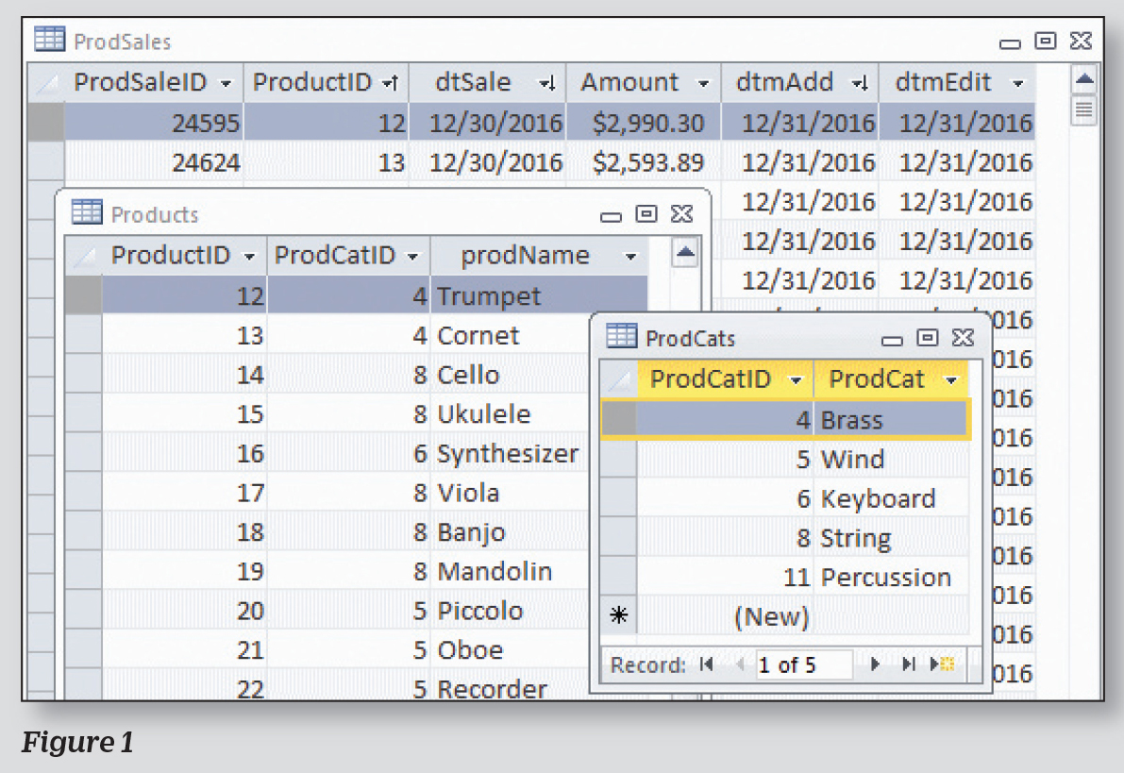
Bases de datos

Slide 13
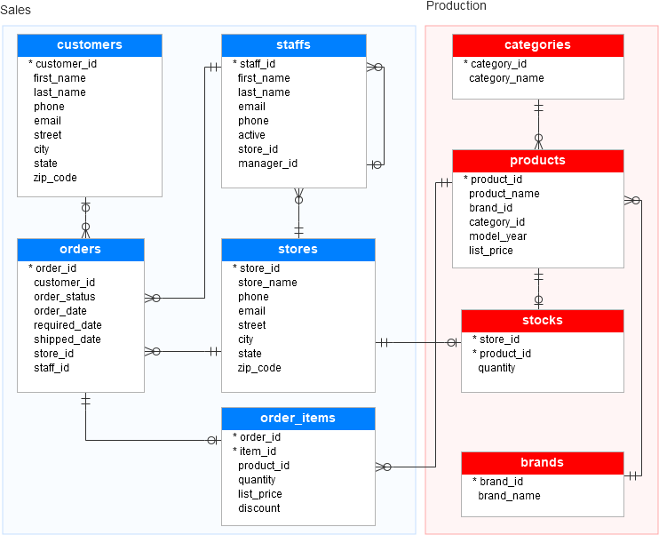
Bases de datos

Slide 14

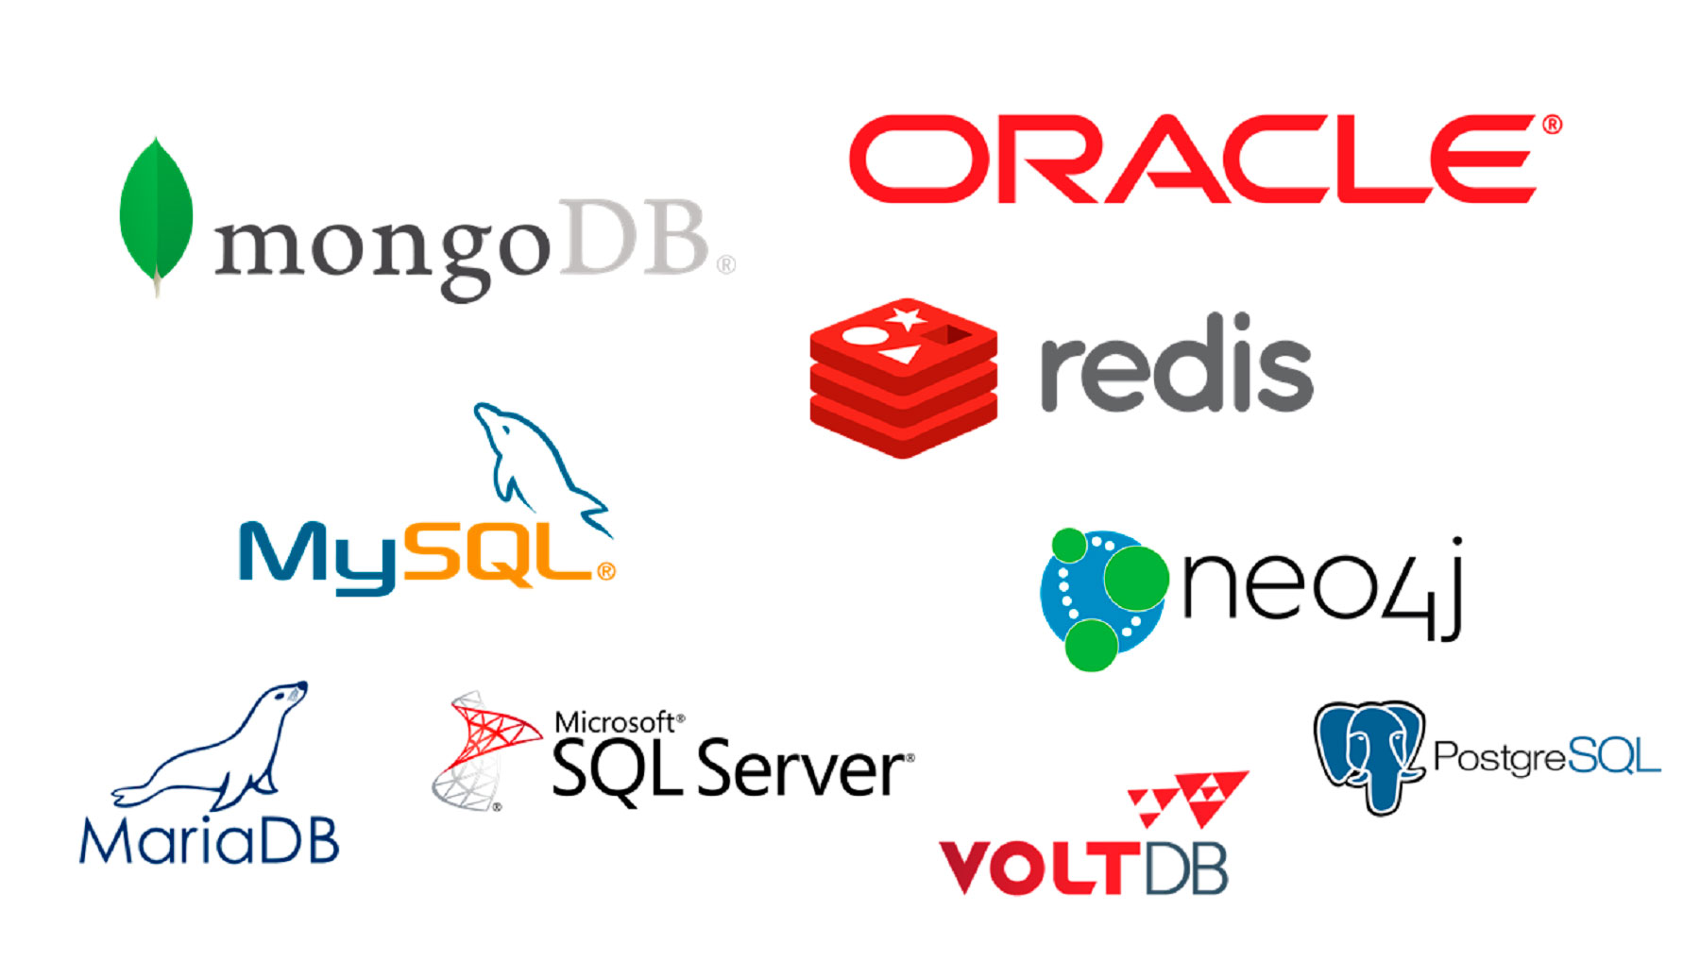
Bases de datos
import sqlite3

Slide 15


